Slide 1
SAP FIORI
Adrian Streitz, Johannes Rank, Borys Levkovskyi

Slide 2
Prerequisites
Fundamental programming skills
Recommended: Completion of the chapter SAPUI5

Slide 3
Agenda
Motivation
Launchpad Overview
App Archetypes
Navigation concepts
The fiori app library

Slide 4
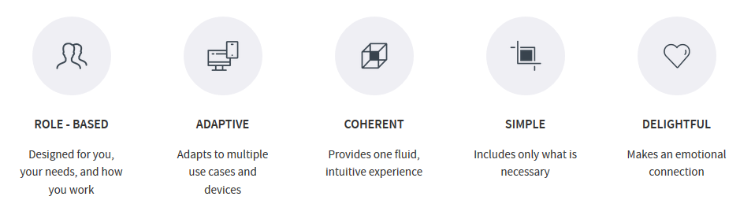
I. Motivation Motivation
According to research, most SAP users used SAP UI to access applications. A GUI with more than 300.000 screens and various functions in it -> SAP recreated the most common applications and integrated them in fiori, a new user experience
Main goal: Personalize and simplify the user experience for SAP applications
Notes:
Umfrage von SAP was können wir besser machen
Meisten leute arbeiten über screen -> aer über 300000 -> Schlicht und einfach zu halten

Slide 5
I. Motivation Distinction between Fiori and SAPUI5
SAPUI5 is a technology
SAPUI5 App: application created using the SAPUI5 toolkit
SAPUI5 is the primary technology used for Fiori
Fiori is a design principle
A Fiori app follows the Fiori design guidelines (usually SAPUI5 components, loaded into an application container)

Slide 6
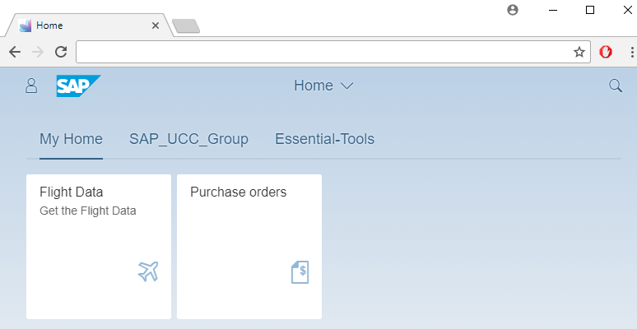
II. Overview Overview
Displayed in web-browser, offering web-like navigation experience (create bookmarks, use web browser‘s back and forward button)
Can be hosted on different server platforms (SAP NetWeaver AS for ABAP, SAP HANA, SAP HANA Cloud Platform)

Slide 7
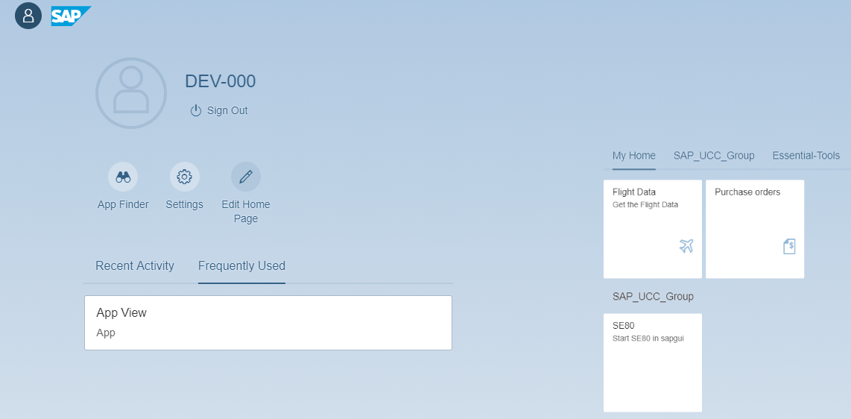
II. Overview Me-area

Slide 8
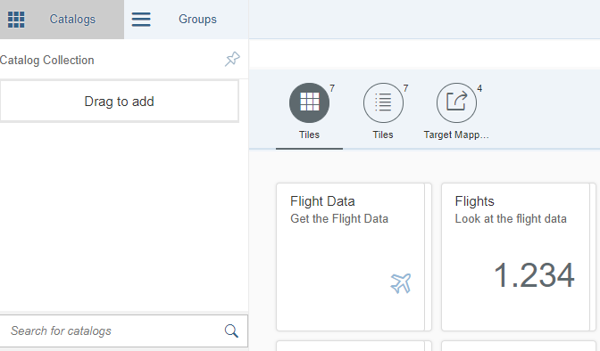
II. Overview Launchpad Designer
Create/manage catalogs, groups and tiles
Create target mappings
Notes:
Zum erstellen von Kacheln und Bereitstellen.
Erste Aufgabe.

Slide 9
You already heard about the SAP FIORI User experience, now take a look at it yourself:
www.sapfioritrial.com
Notes:
Vorteil im Vergleich zur SAPGUI

Slide 10
III. Navigation concepts Navigation basics
Offers web-like navigation experience (open new tabs, create bookmarks, back & forward buttons)
SAP Fiori launchpad supports navigation based on URL fragments, intent-based, cross-app and inner-app navigation

Slide 11
III.Navigation concepts Tiles, Catalogs & Groups
In fiori, applications are referenced through tiles, structured in catalogs and groups
Tile: Starts the application (by using a target mapping). Can be selected from catalogs and arranged in groups.
Catalog: Set of apps made available for a role. A User can search the catalog, select apps out of it and add them to his entry page.
Group: Subset of a catalog, consists of the apps visible on the launchpad. Can be assigned to a role, so that the end user doesn‘t have to add the desired tiles himself.

Slide 12
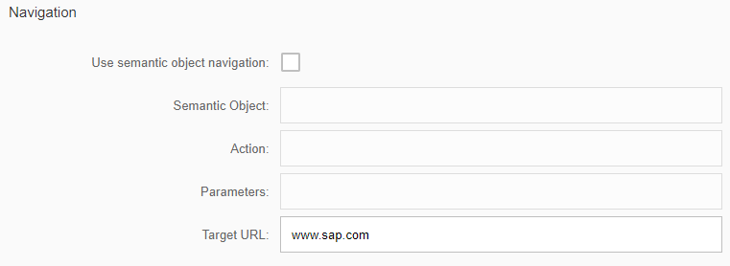
III.Navigation concepts Navigation
Two main ways:
Via Target URL (dependent or independent)
www.sap.com
/sap/bc/ui5_ui5/sap/z_mvc_app_000
Intent based (semantic object navigation)
uses target mapping
decouples navigation-trigger from navigation-target -modify the target application without changing the trigger - choose the target depending on role or device type
Notes:
???
Use semantic objects = no unchecked (URL)

Slide 13
III. Navigation concepts Navigation by intent
Navigation in fiori consists of semantic objects and actions
Semantic object: Represents business entity (customer, sales order or a product). Refer to objects in a standardized way, abstracting from concrete implementation of these objects
Action: Describes which operation is intended to be performed on a semantic object
Intent: Combination of a semantic object and an action. Can be resolved differently, based on the role of the user, that triggers the navigation.
Target mapping: Defines the intent, navigation target, supported device types and additional parameters. Is triggered when a tile is selected
Notes:
Evtl. anhand eines Bild verdeutlichen. Kachel, LandingPage der Webanwendung, Pfeil (Target mapping)
Entität des semantischen Objekts, CRUD operations

Slide 14
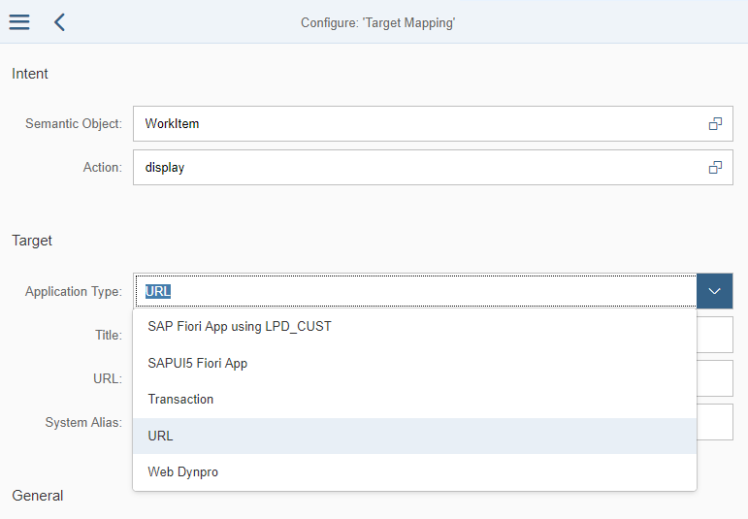
III. Navigation concepts Navigation by application types
SAP-Fiori-App using LPD_CUST
SAPUI5-Fiori-App
Transaction
URL
Web Dynpro
Notes:
Ist das hier die Konfiguration des Target Mappings?
Navigation bei intent? Oder ist das Navigation by URL?

Slide 15
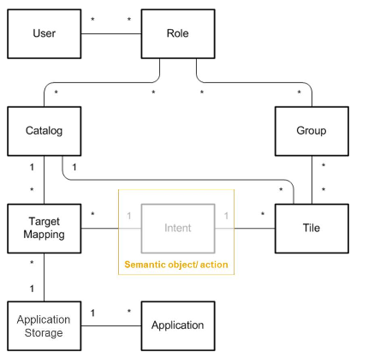
III. Navigation concepts Overview
Notes:
Ist nicht die Group ein Subset von Catalog
Was ist Application Storage?
Habe ich als Rolle immer die Berechtigung für einen Catalog oder kann ich das auch Gruppenweise vergeben
(Gruppe ist sichtbar im Launchpad, Catalog ist nur eine Bibliothek von Apps die ich zur Verfügung habe)
Warum Target Mapping mit Catalog verbunden?

Slide 16
III. Templates App Archetypes
There are three basic app archetypes available
Transactional Apps: Used to perform transactional tasks
Fact Sheets: Display contextual information and key facts about central objects used in business operations. (Only run on SAP HANA)
Analytical Apps: Insight into real-time operations, displaying key figures directly in the browser. (Only run on SAP HANA)
Notes:
Implementierung der App Archetypes? -> wählt man zu beginn eine App aus oder sind diese Templates mit den Tile Types gleichzusetzen?

Slide 17
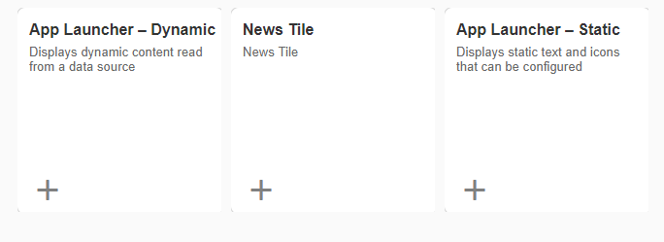
III. Templates Tile types
Static App Launcher: displays static content, configure title, subtitle and icon
Dynamic App-Launcher: displays data that is updated at regular intervals (via OData services)
News Tile: Displays a news feed alternating between messages (rss-feeds)
Notes:
Sind die verschiedenen Tile Types alle auch ohne HANA verfügbar

Slide 18
Now you know the basics about the core principles of SAP Fiori.
To consolidate your knowledge, you can do tasks 1 of the SAP FIORI exercise.

Slide 19
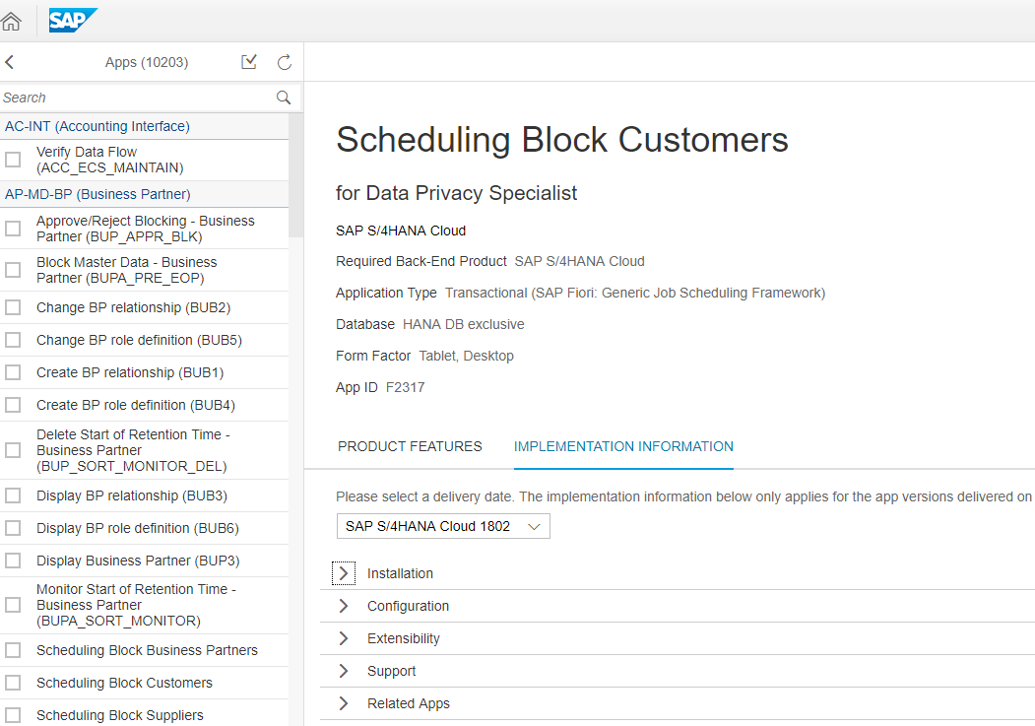
III. The fiori app library Fiori apps library
SAP offers common transactions in the form of fiori applications
Features and implementation information/ requirements are stated

Slide 20
Check your knowledge

Slide 21
Check your knowledge
What is the advantage of using the transaction LPD_CUST, instead of linking the SAPUI5 app directly in the Launchpad designer?
In which cases is a semantic object needed?

Slide 22
Solution

Slide 23
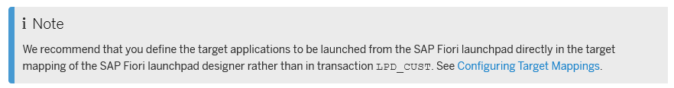
Solution
What is the advantage of using the transaction LPD_CUST, instead of linking the SAPUI5 app directly in the Launchpad designer?
-> None

